Slide 1


Team s Stage 3
Wait
Less
Team Members:
Edmund
Evan
Karan
Robert
Amman
Teaching Assistant:
Philmo Gu
Notes:
Introduction:
“Hello and welcome to the Team S Stage 3 presentation. I am ”Amman”, and our team is made up of Edmund, Evan, Karan, Robert, and Myself. Our Teaching Assistant is Philmo Gu.
We will briefly go over our Project Idea which is called the WaitLess. It’s aim is to improve the virtual academic advising experience for students by refining and simplifying a virtual line up system. We went with a mobile application approach as it is the most accessible for students on the go. When they need advising, virtually lining up is as easy as just hitting “Join Line.” While the student waits, they are updated about their placement in the line regularly, removing the need for the student to constantly check how long they have. A chat and FAQ feature that provides the student with quick answers to surface level questions they have. There are more features that we will be discussing next in our low fidelity prototype system:

Slide 2

Demo Video
Insert demo video here!!!

Slide 3
Journey in Stage 3
Our Ideation Process
Notes:
The Journey In Stage 3 for our team was quite an informative one. Brainstorming and affinity diagraming resulted in us refining our idea for the system. The low fidelity prototype that we just showed was analyzed using a Cognitive Walkthrough evaluation. All of this an more will be discussed in the following slides.
As a quick overview of what we’ll discuss, we first brainstormed sketches and ideas about the waitless app. Those ideas where then brought together with an affinity diagram drawing session and the top three ideas from that diagram were picked. The most promising one was then developed into a story board which we drew by hand. We then designed a low fidelity prototype about our system and conducted a cognitive walkthrough to refine and update tasks and ideas. The updated low fidelity prototype was just shown as part of the demo video.

Slide 4
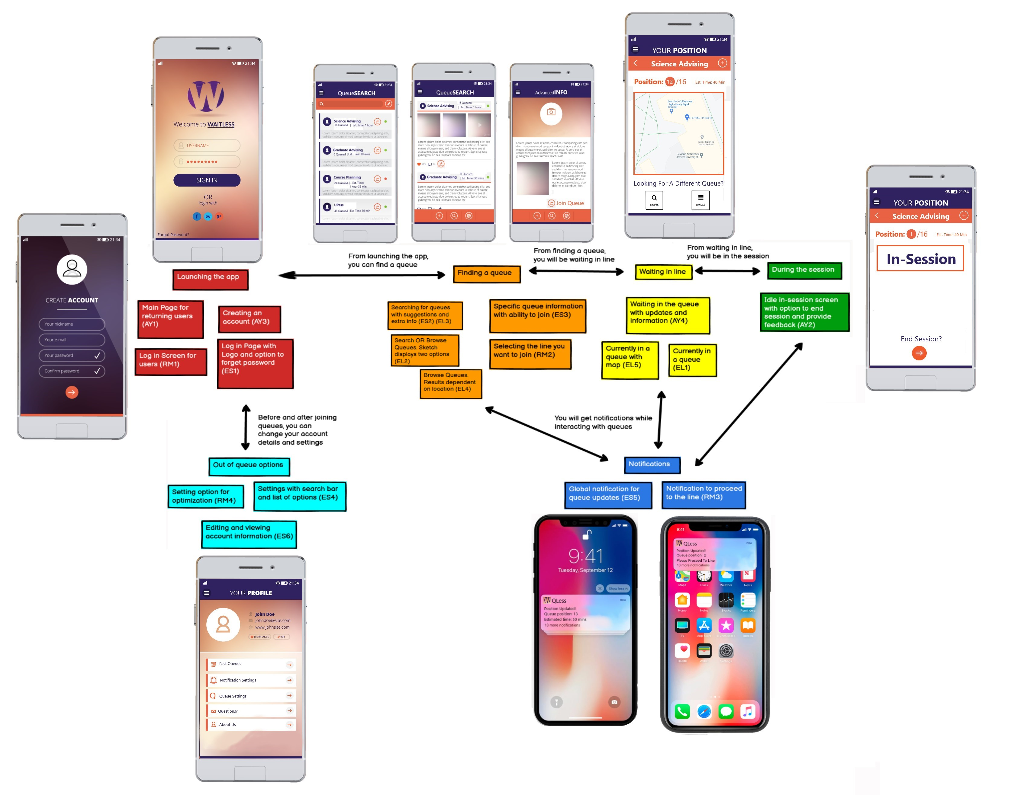
Affinity Diagram
Notes:
This is a general overview of our affinity diagram. We included functional ideas that describe what the sketch/idea is doing and also visual layout ideas of our sketches

Slide 5
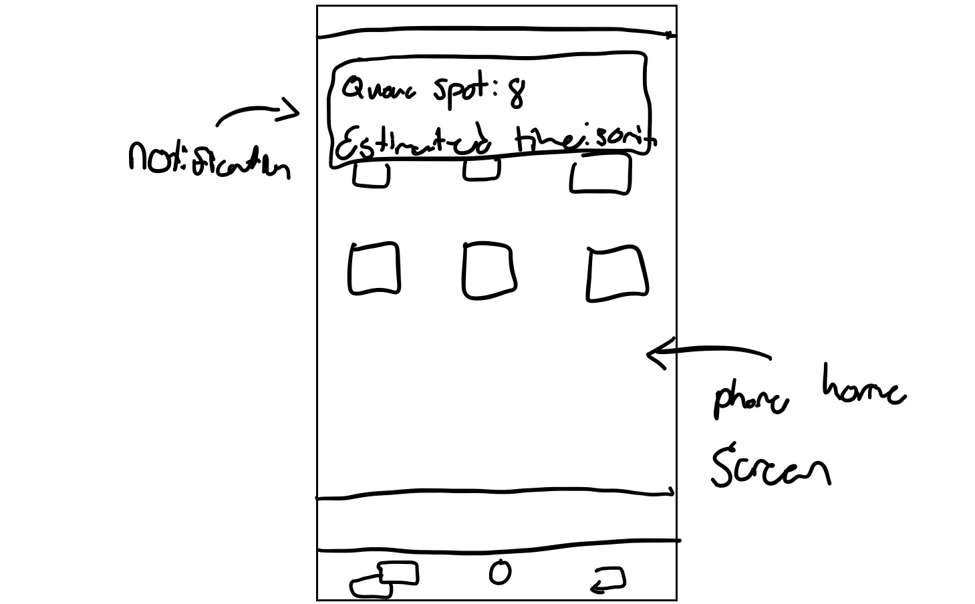
Affinity Diagram
Brainstormed ideas and sketched them out on paper
Wrote down the main idea
Global notification for queue updates (ES5)
Notes:
We started off with a brainstorming session that generated a number of ideas, like the sketch on the right.
From our brainstorming session, we extracted the main idea that a sketch was trying to convey so that we can group them later on. For example, here we have a sketch that is trying to display a notification system idea where the user will be notified when their placement in line was moved up.
We also extracted layout ideas and designs from these sketches that we included later on. (may remove this)

Slide 6
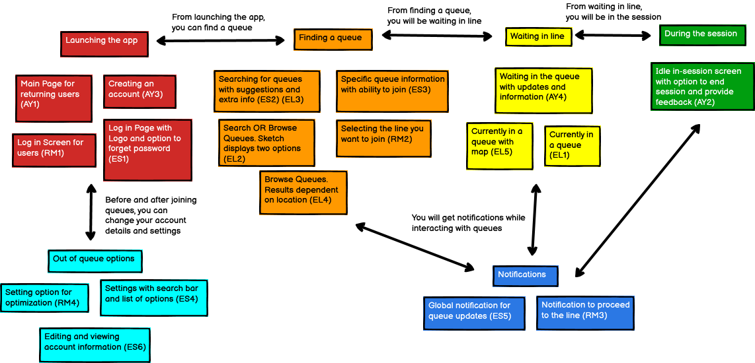
Affinity Diagram
Grouped ideas based on _____
Drew connections between the groups
Represented workflow
Notes:
Once we extracted the main ideas of the sketches, we grouped them based on which stage of lining up a user is in, or in other words, “workflow.”
For example, we have a “Launching the App” group on the left that revolves around what should be displayed on the screen when you open the app. Our sketchs ranged from a main page landing screen to a log in greeting.
Most of the groups are aptly named, like the “Waiting in Line” group that includes the pages that show up once a user is in a line, like a map or important information.
To help figure out the workflow of our application and how different pages of the app relate, arrows were drawn between groups. A justification/description of how to move between the different groups was also included. For example, you’ll be able to get to the “Waiting in Line” ideas from “Finding a Queue”

Slide 7
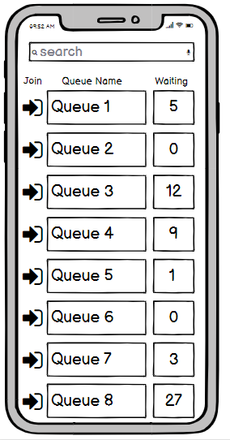
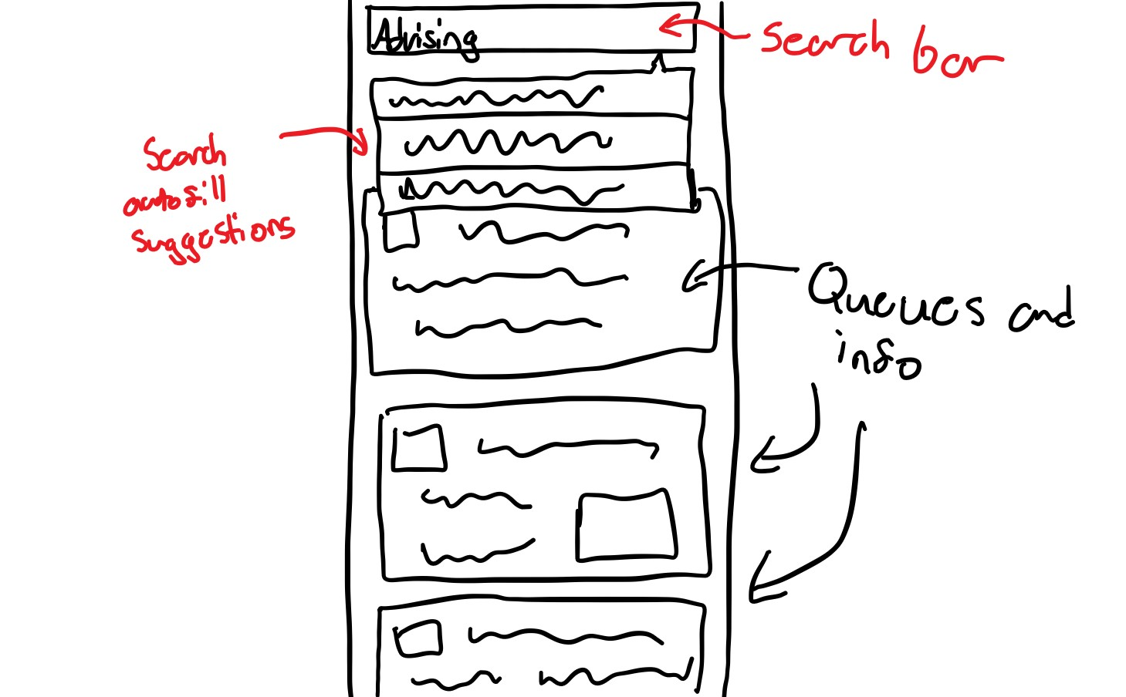
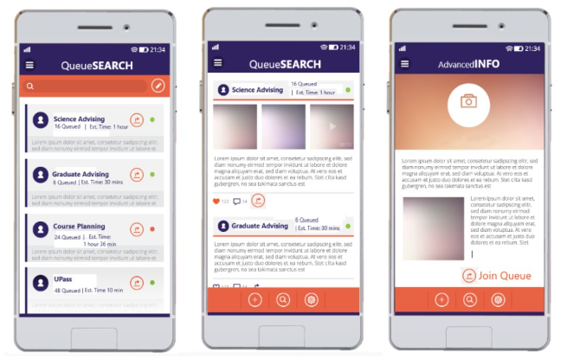

Affinity Diagram
Combined different sketches of the same group into one good quality design
Demonstrated how the app view may look
Narrowed down look and layout of design
Notes:
Once we extracted and grouped the main ideas of our sketches, we also combined the sketches of our grouped ideas into one design. …….
In this example to the right, these two sketches shared a possible search display implementation in our system. The look of these sketches were then combined to form a set of possible design implementations of our search system. Colours and layout ideas were also generated so that we can nail down the look of the app.

Slide 8
Ideas Ditched?
Idea 1
Small justification
Notes:
Some ideas that we got rid of are the following:

Slide 9
Selecting and Polishing 3 ideas
Top 3 ideas were picked from brainstorming
Notification idea was chosen for the story board
Push Notification with relevant line info
Common questions and general info before joining line
Display map, queue position, est wait time while in line
Notes:
From our affinity diagram, we moved onto refining our final idea. We started with selecting 3 of the top ideas from our brainstorming and affinity diagraming session.
The first idea was a push notification feature that updates the student once they moved up in the virtual line. The notification also includes estimated wait time as well as the position of the student in the line.
The second idea was to display queue information such as common questions, whose it for and other info before the person hits “Join Line.”
The third idea was to have a map, queue position, estimated wait time, and queue name after the person has joined in line.
Finally, we chose the notification idea as the most promising of those three as it was the most unique sounding one. And so it was chosen to be included in a story board to further refine that idea.

Slide 10
Story Board
Notes:
We designed this story board with completing the user task of getting notified about line placement in mind.
Our most promising idea, a global notification about placement in line was integrated into this.
The scenario starts with a first year art student Richard looking for help selecting courses. Richard is then advised that our mobile app is being used as a virtual line up system. This is perfect for Richard as he is able to study for an upcoming midterm instead of waiting in line. Richard joins the queue he wants using WaitLess. He is presented with a vibrant screen that displays the estimated wait time for the advising session. Richard then uses that time to study. He lost track of time from all the studying he’s been doing, but luckily, waitless has an automatic notification feature that informs Richard that he has moved up in the line. This makes sure that Richard is on time to the advising session as he is able to manage study time effectively with the WaitLess notifications.

Slide 11
Lessons learned in Lo-fi
Need to consider large number of interacting elements in our design. Important to consider the flow between each page
How to effectively lay out a page on a small phone screen. Minimized info on the page to only most urgent
Colour and icon design are important. Lo-fi was looking dull so we added some random colour combination to make clear distinctions.
Notes:
While creating the Lo-Fi Prototype, we learned about just how many elements of our prototype need to interact with each other. We initially thought our design would be very simplistic, with only a few separate UI’s being needed, but this was definitely not the case. Even with a simple idea, there is a lot of stuff going on and needed for a full user experience such as having various buttons that give details about specific lines, or notifications and alerts to drive the user in the right direction. We also learned how to properly lay out each page, given the small phone screen to work with. We were able to do this by simplifying a lot of our titles to just be icons such as the “About/FAQ”, Profile, and settings pages. This was also achieved by displaying only the most urgent and minimal information about the line to the user such as the distance and number of people in the line. The remaining details about the line were left for the about page. Finally we learned how much design and colour plays a role in the UX for our app. When initially creating this prototype, we wanted to limit colour and details so that the functionality of our app stood out. However, we were left with a prototype that was lifeless and hard to look at. So we added some random assortment of colors to make a bigger distinction between certain parts of the app. For our high fidelity prototype, we will consider colour combinations to a greater extent.

Slide 12
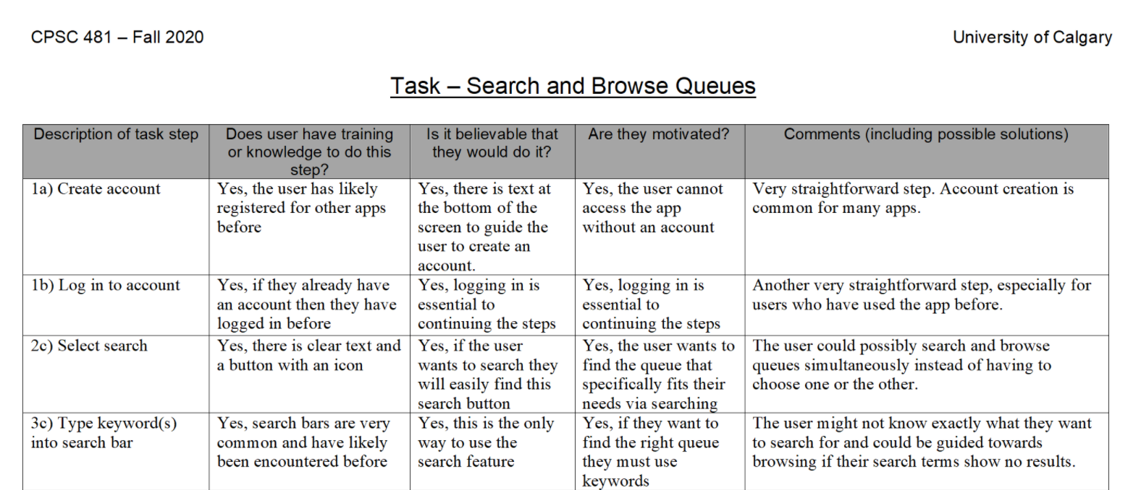
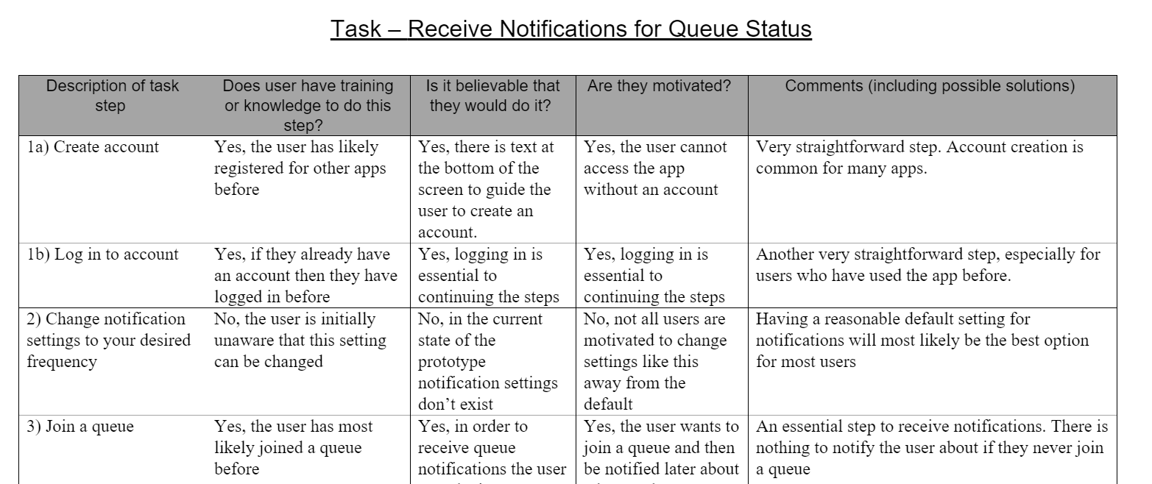
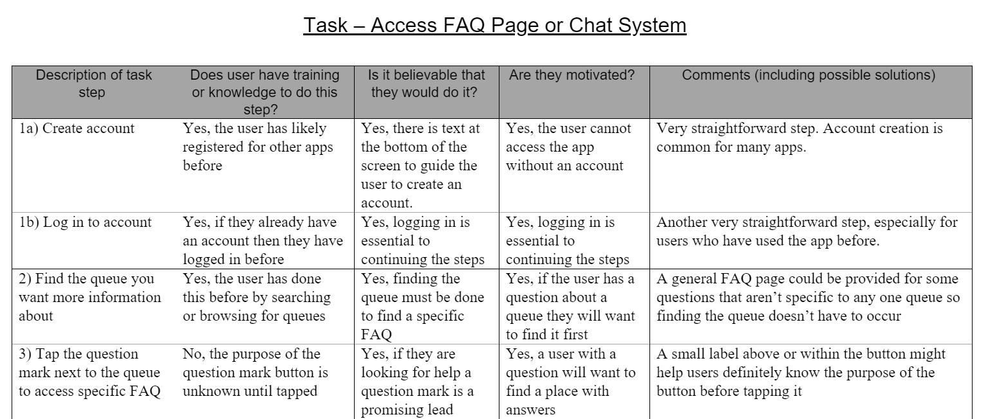
Cognitive Walkthrough Evaluation- Process
Took the 3 tasks that we implemented vertically in our prototype and used the cognitive walkthrough evaluation on them
Search and browse queues
Receive updates on queue status
Access FAQ page or chat system about a line
Took the perspective of a user/student
Assumed to be more technologically advanced
Outlined step by step what should be done in order to complete that task
Notes:
Now we will move onto our cognitive walkthrough evaluation. We will first talk about the process we took in order to complete this.
Initially, we discussed and took 3 of our user tasks and implemented them vertically into our low fidelity prototype. These user tasks include searching and browsing queues, receiving updates on the status of queues, and accessing an FAQ page or chat system about a certain line up. We then took a look at each of these implemented tasks using a systematic cognitive walkthrough evaluation. Each vertical task was completed by using a student point of view as we expect our system to be used by them. Furthermore, each task was broken down into sub-tasks to get a clear sense of how a student interacts with our system using our design.

Slide 13
Cognitive Walkthrough Evaluation
What Was Learned
Student perspective allowed for familiarity in completing sub tasks
Finding FAQ page of a line was not clear
Student not that motivated to browse over many queues
What was Changed
Added “need help?” feature to help with the FAQ uncertainty
Default sorting of queues to browse based on most relevant
Set “notifications” to on by default, allowing the option to change it manually later
Notes:
We will now talk about what was learned as a result of our cognitive walkthrough evaluation. We found that taking the student perspective when completing the tasks allowed many of the sub-tasks such as searching based on key words and logging in to feel more familiar.
We also learnt that finding an FAQ page of a line was not as clear as it let on to be. FAQ icons were provided to hint the user that they are supposed to click on it, however there was no descriptive text to confirm this. One other thing that we found was that a student would not be that motivated to browse over more than a few queues. Looking through non-relevant line ups can be challenging.
As a result, we changed a couple of things in our low fidelity prototype to reflect the result of our cognitive walkthrough evaluation. We added a “Need help?” feature to let users know where to click regarding the FAQ uncertainty. To make the browsing of queues more motivating, we set the default sorting of the queues to brows based on relevancy. This relevancy can be based on most frequented queues and/or location. Finally, we set the default setting of the “notifications” feature to ON. This allows the user to take full advantage of the notification system our app provides since it may be likely that they are unaware that this system exists.
Overall, this cognitive walkthrough evaluation was extremely useful in the development of our low fidelity prototype as it highlighted certain features we looked over when first designing.

Slide 14

Conclusion & Thank you
Portfolio: https://rmccurdy.github.io/TeamS_Project/
Repository: https://github.com/RMcCurdy/TeamS_Project
Notes:
Thank you for listening to our stage 3 presentation. You can learn more about our project in the links on this slide.

